Slide 1
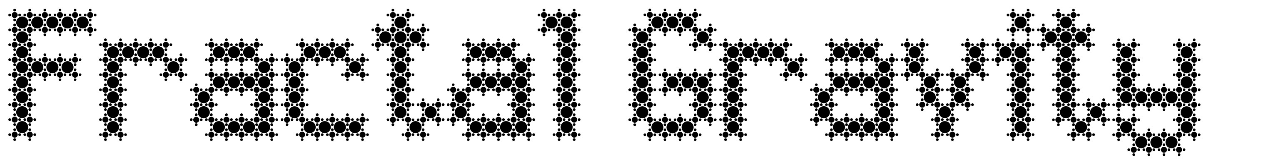
Gavin Lucsik

Slide 2
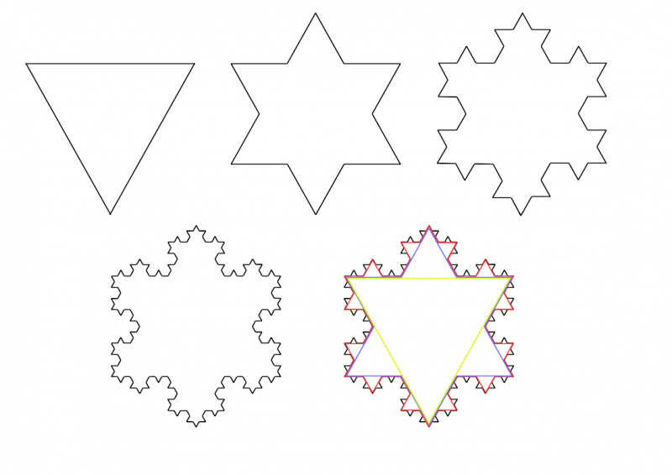
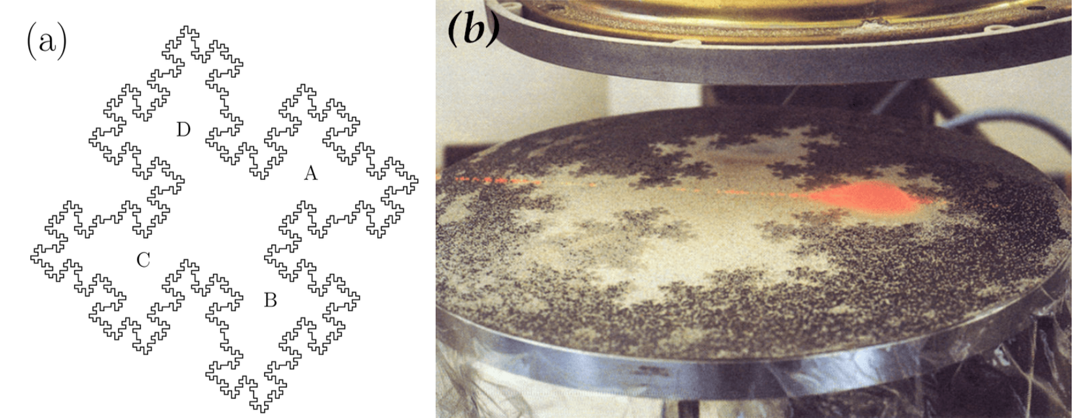
Motivation:
Fractals are purely mathematical objects, in which some pattern is iterated.
They are not often studied in physical contexts. However, they are sometimes imbued with physical properties…
In 1966 Mar Kac introduced the ‘Fractal drum’, a fractal that exhibits drum-like eigenmodes (Simonsen et al., 2023)
In 2014 the Koch snowflake was used as a ‘table’ to simulate a billiard collisions (Lapidus & Niemeyer, 2014).
Lapidus, M. L., & Niemeyer, R. G. (2014, March 23). The current state of Fractal Billiards. arXiv.org. https://doi.org/10.48550/arXiv.1210.0282
Simonsen, V. P., Hale, N., & Simonsen, I. (2023, September 24). Eigenmodes of fractal drums: A numerical student experiment. arXiv.org. https://doi.org/10.48550/arXiv.2309.13613

Slide 3
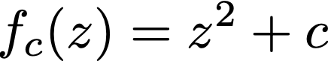
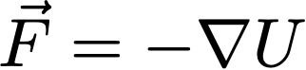
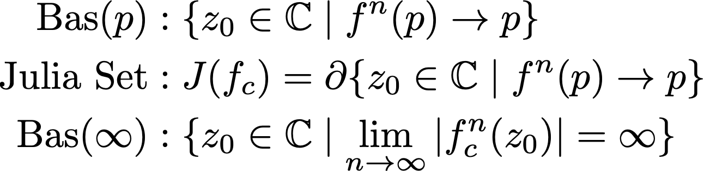
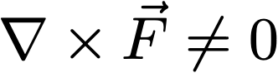
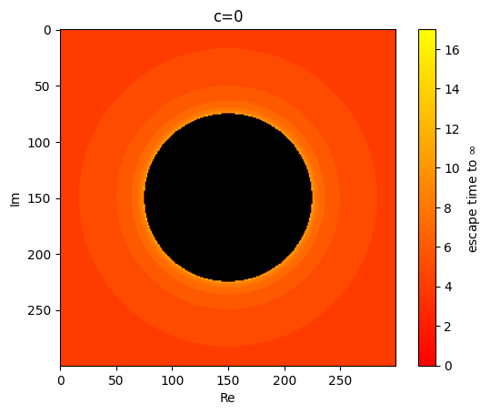
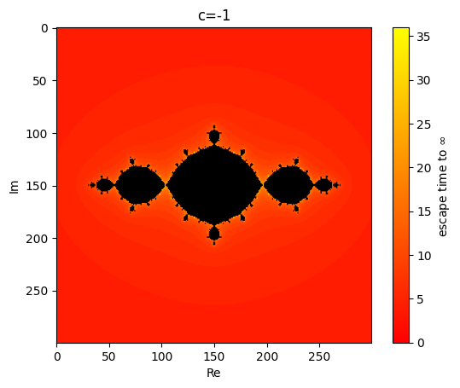
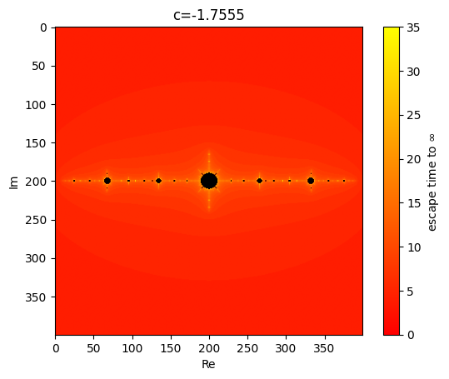
Model:
Using the ‘escape time’ of points z, we can define U such that
Definition of a Julia Set:
for a map, ,
{non-conservative}

Slide 4
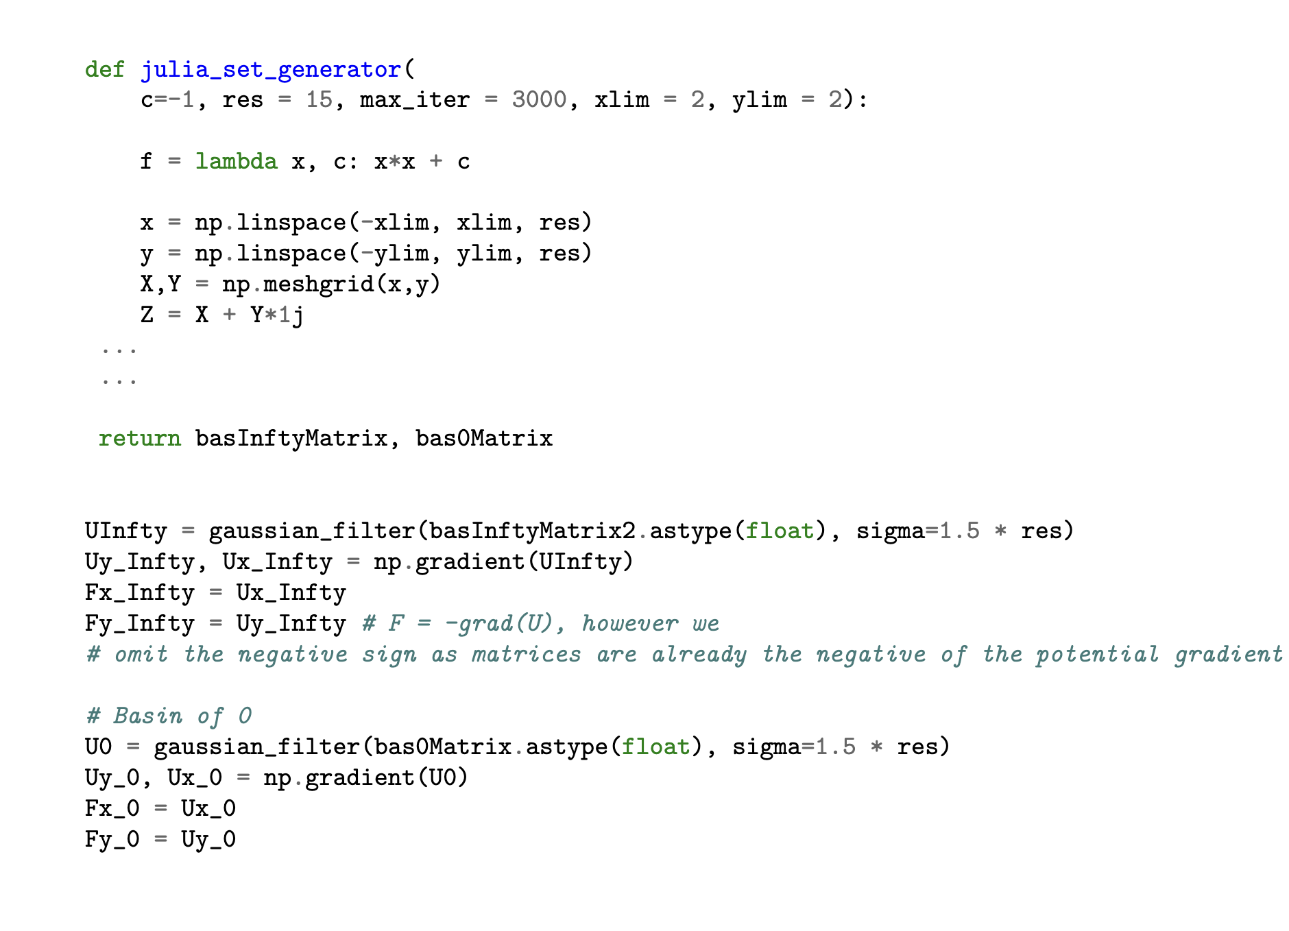
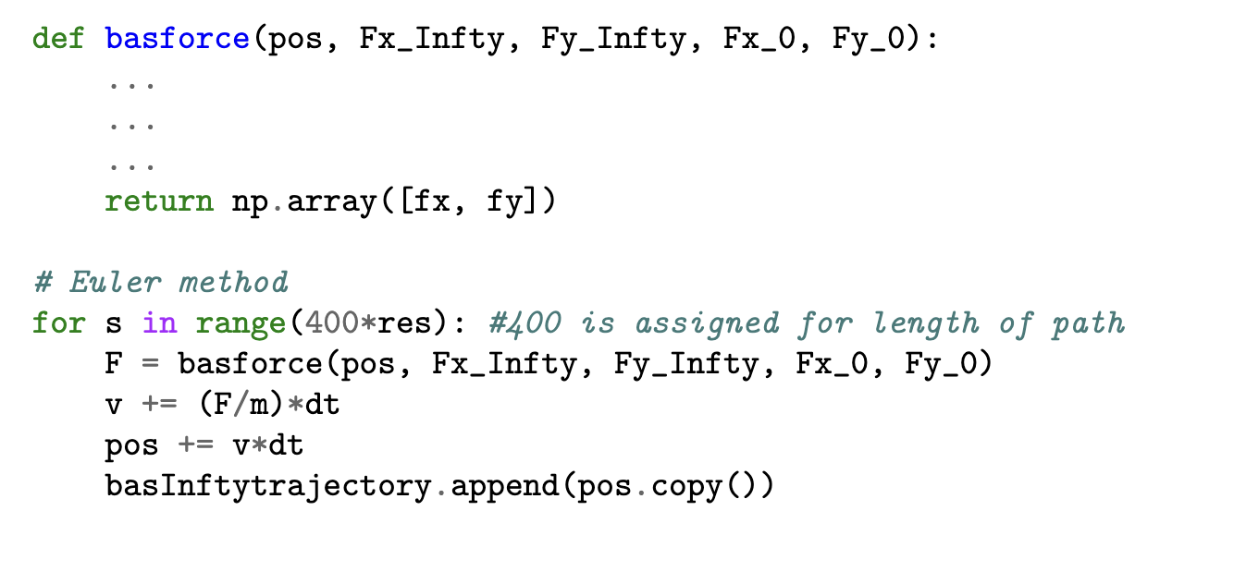
Code

Slide 5
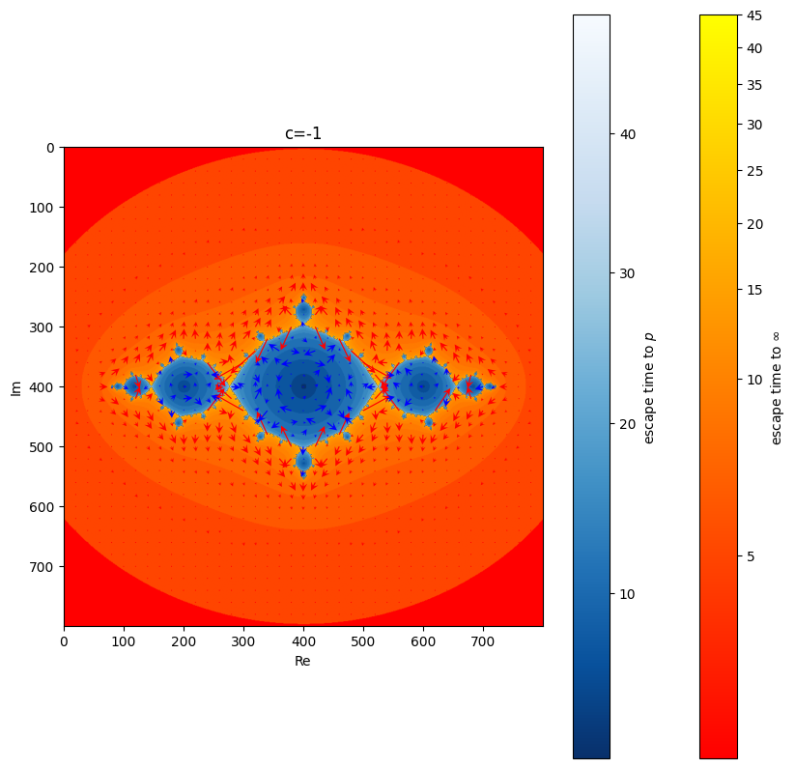
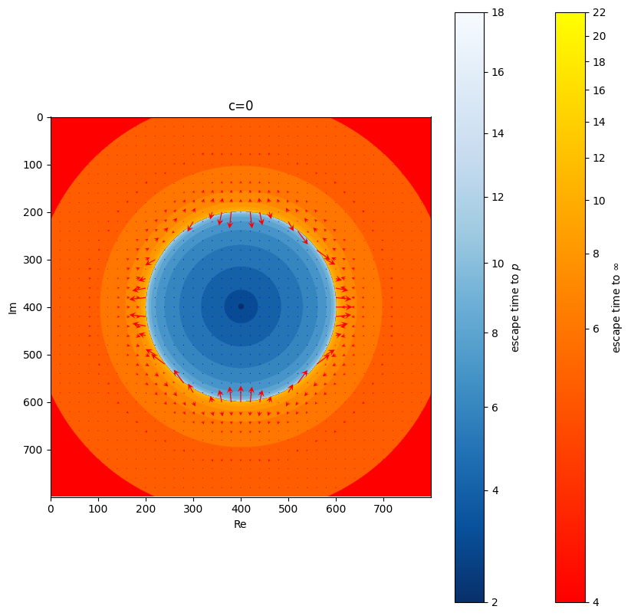
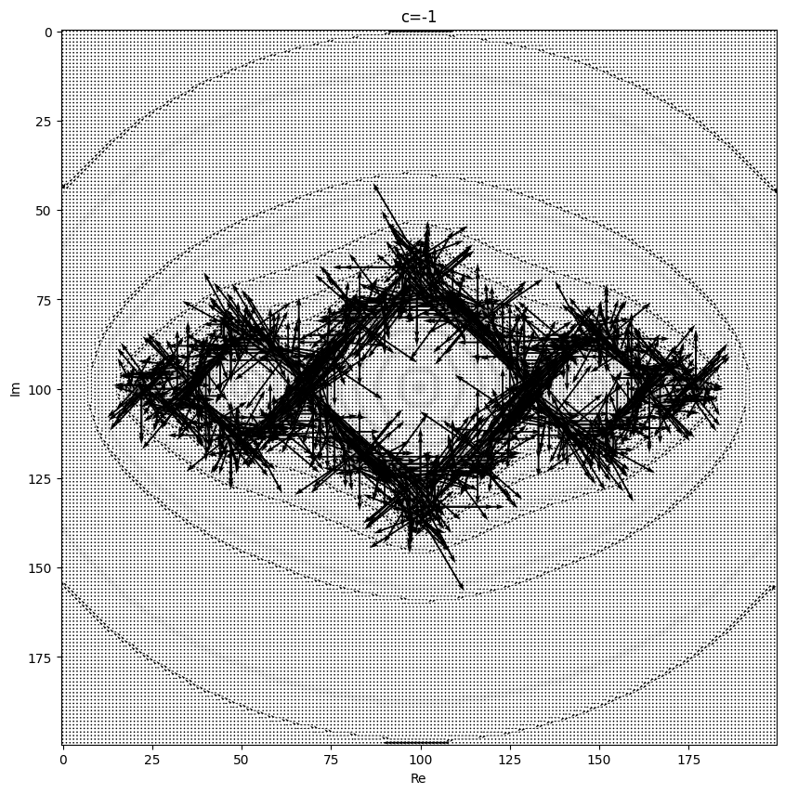
Define Vector Field of U
Define inner structure of Bas(p)

Slide 6
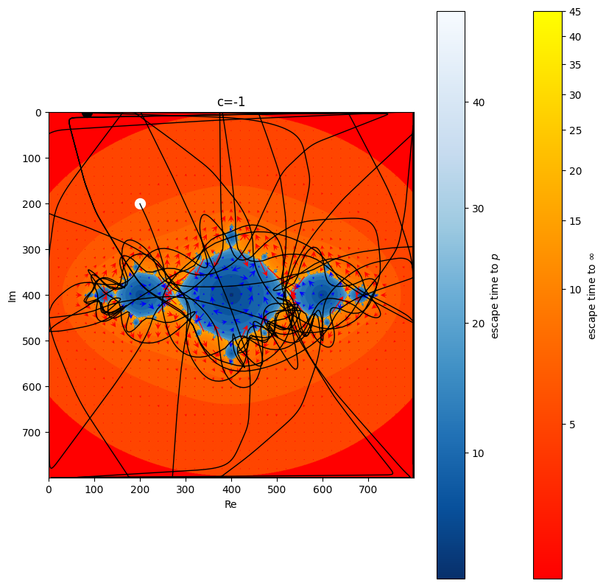
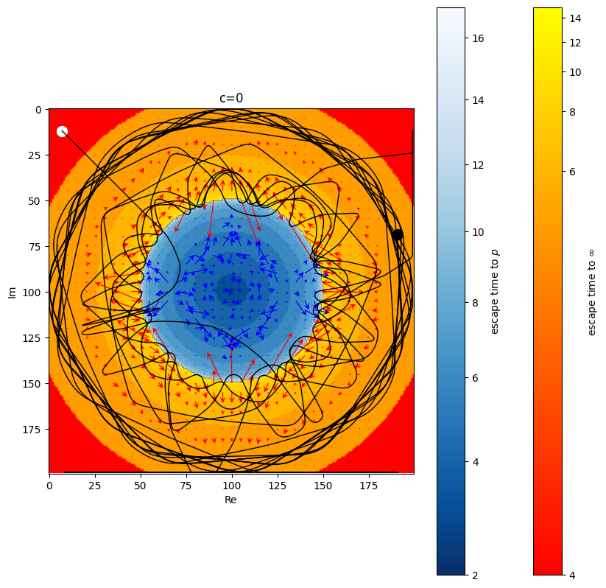
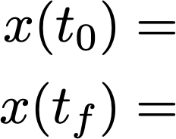
Results:
is certainly true, energy is not conserved
Non-Trivial
Trivial
White
Black

Slide 7
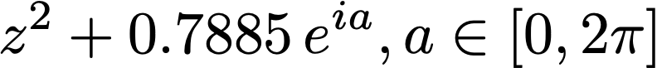
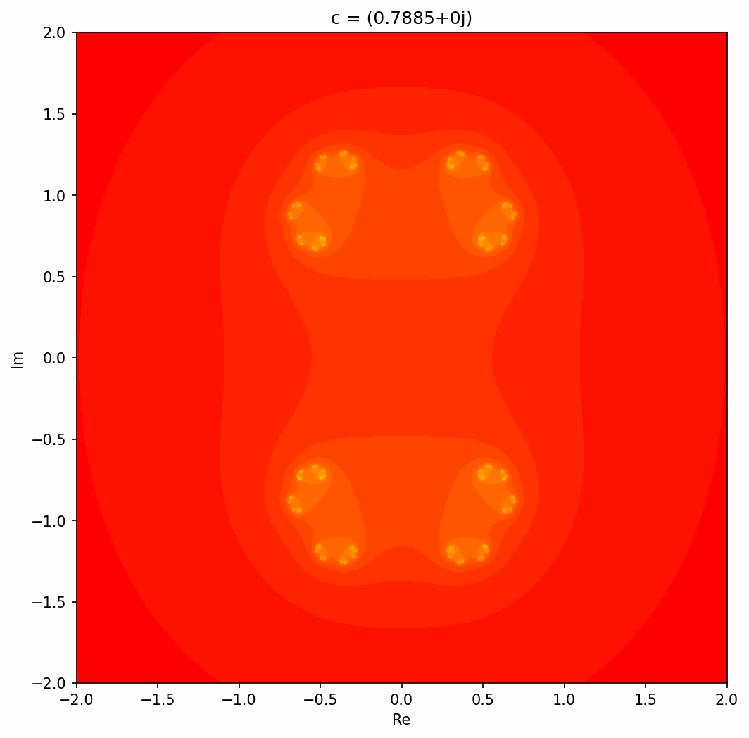
Julia Sets on Closed Loop:

Slide 8
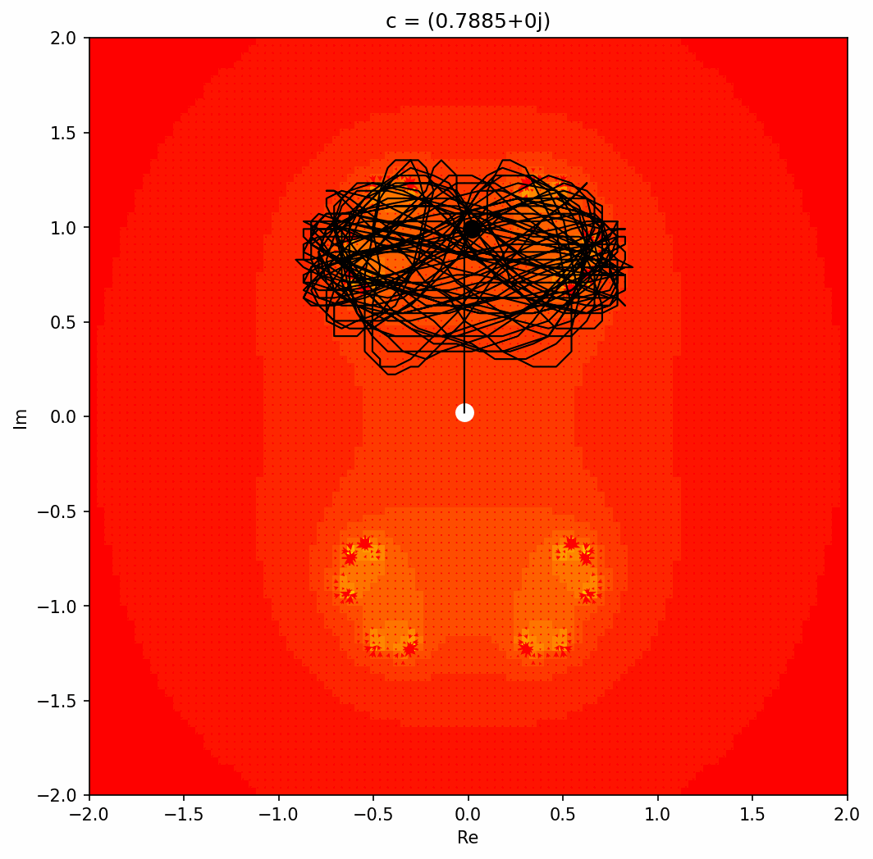
Trajectories throughout a closed loop:

Slide 9
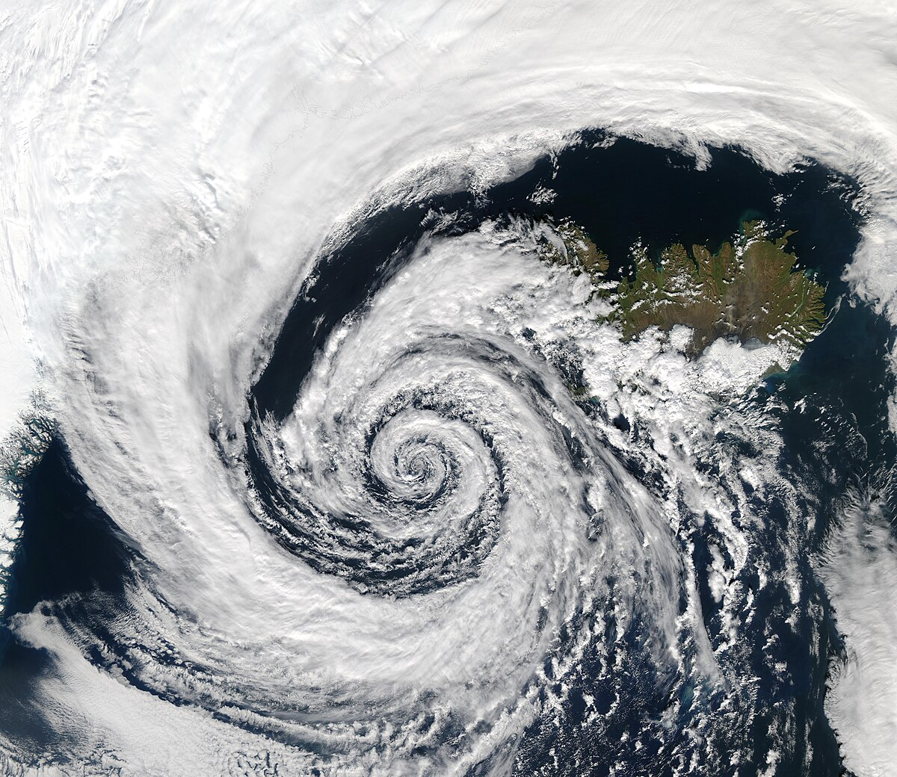
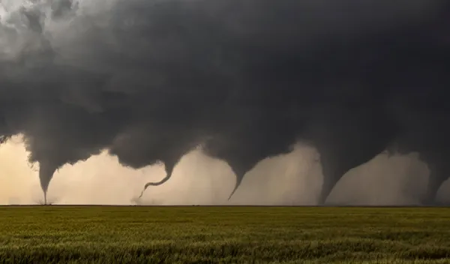
Physical analogues
A particle trapped in a highly compressible fluid, subject to aperiodic forces.
e.g. Hurricanes, Tornados
Energy is ‘lost’ as heat and sound, and can be modeled as a non-conservative interaction, hence chaotic motion.

Slide 10
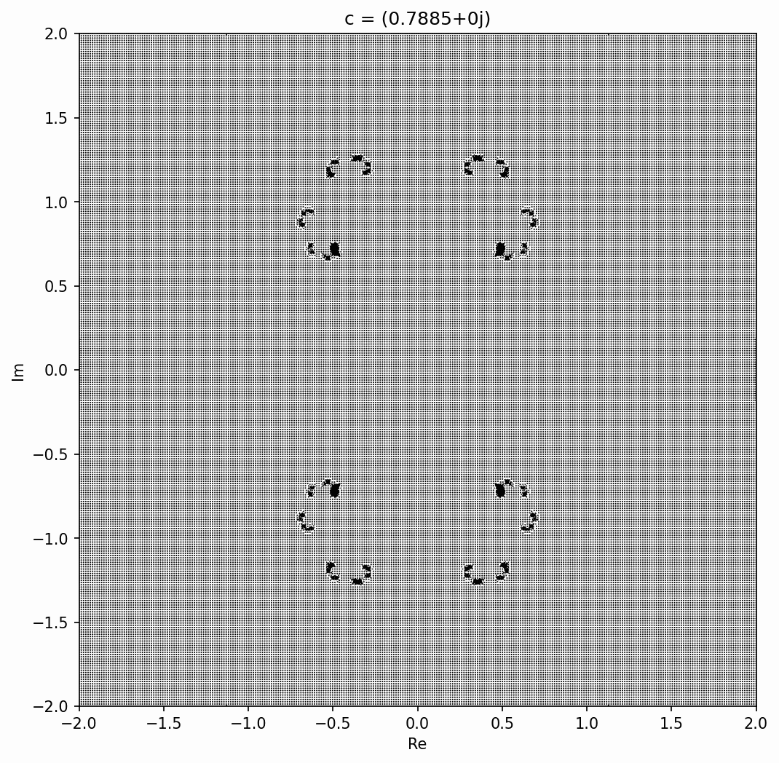
Summary
{non-conservative}

Slide 11
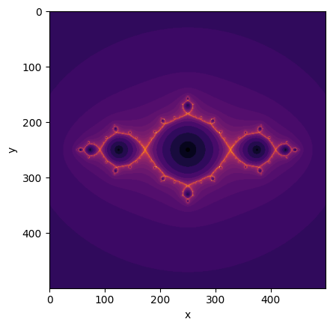
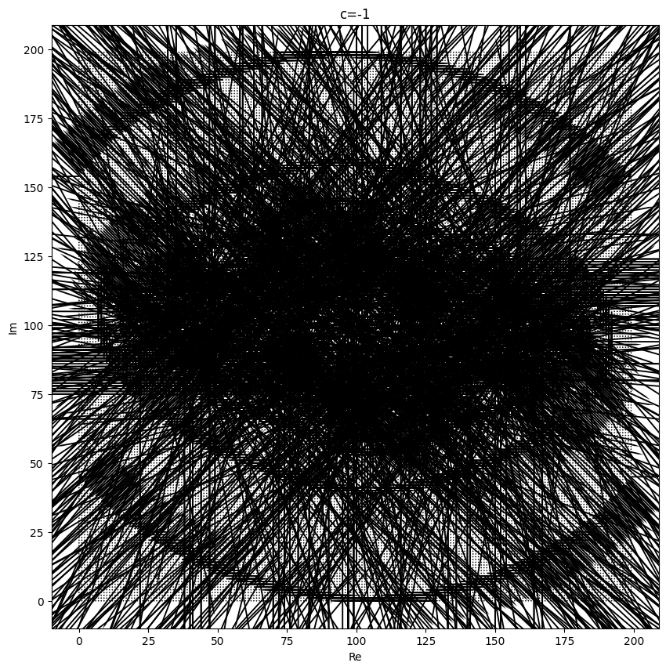
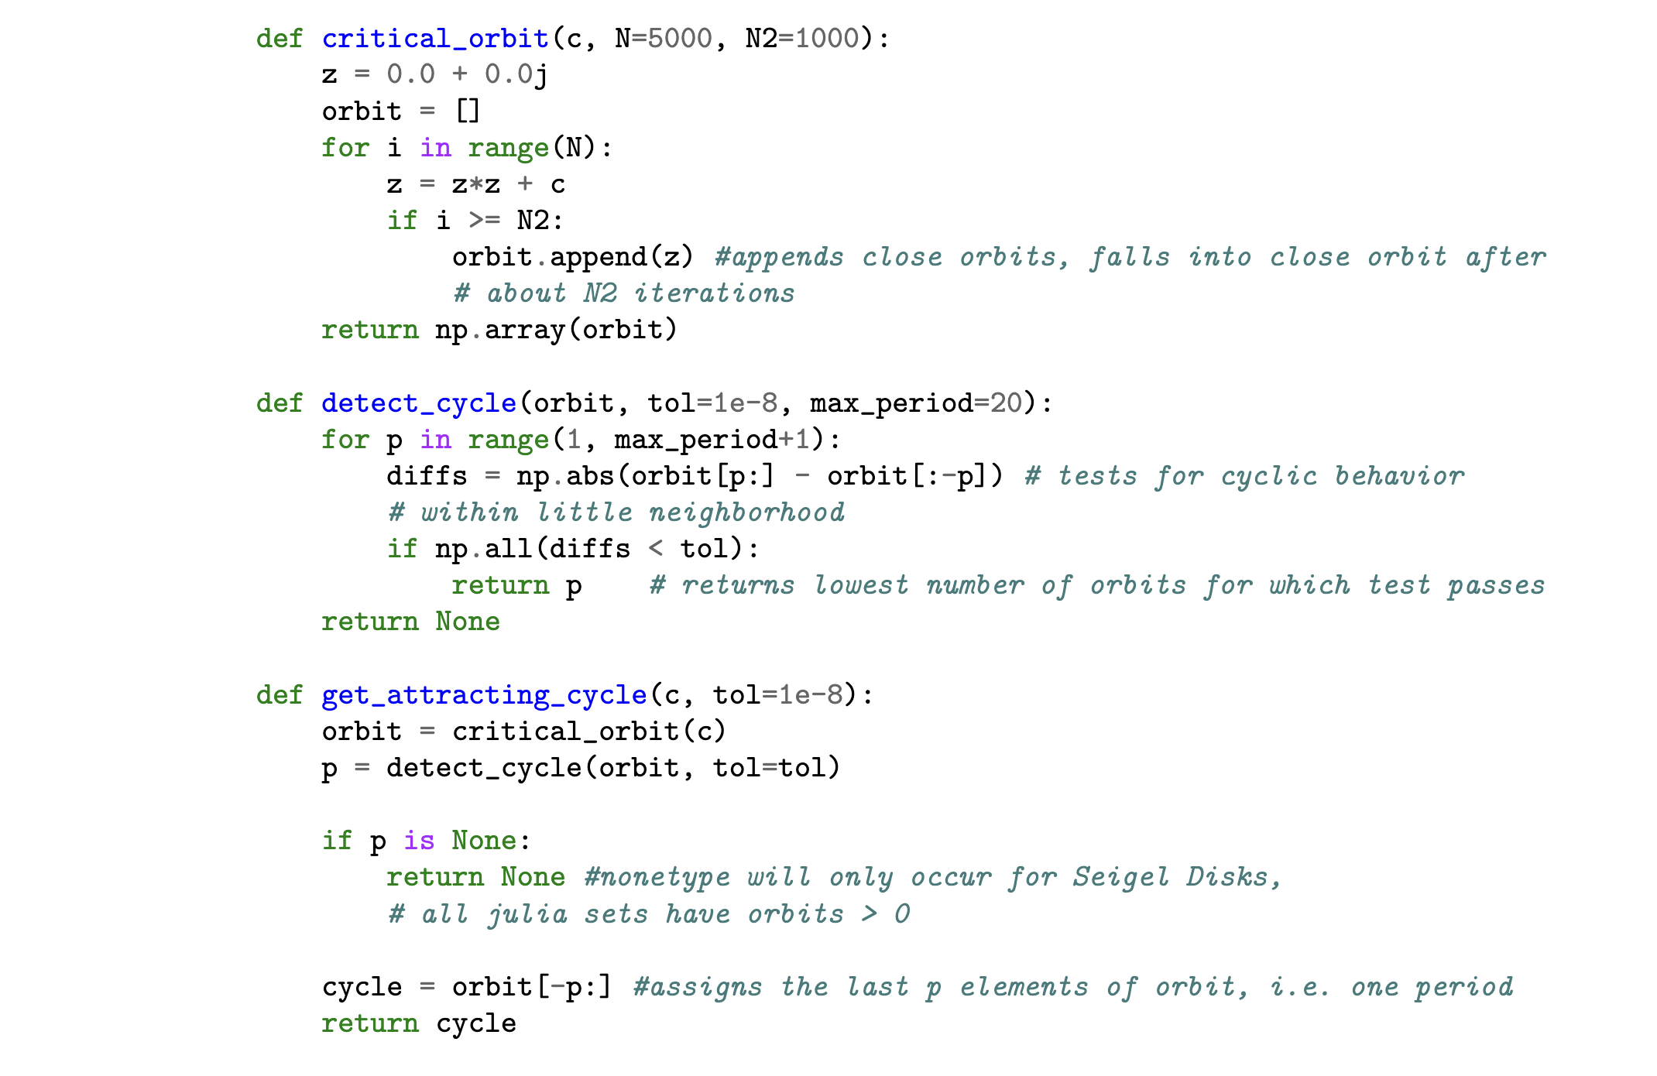
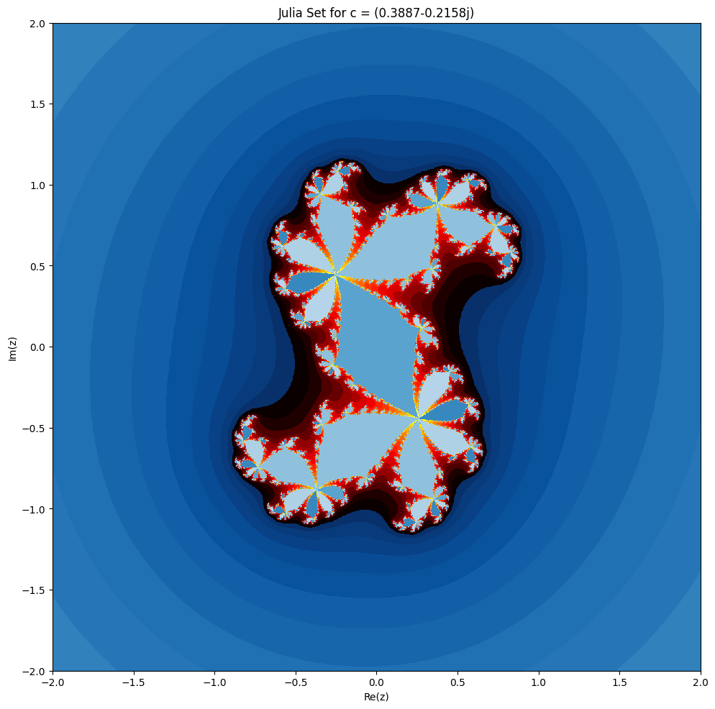

Questions resevoir
https://github.com/glucsik

